Slide 1

SBM PRINCIPLE 2
CURRICULUM AND INSTRUCTION
VIOLETA H. BINALON

Slide 2
WHAT IS YOUR IDEA ABOUT
CURRICULUM
INSTRUCTION

Slide 3
WHAT DATA CAN YOU GIVE AS BASIS TO IDENTIFY LEARNERS NEEDS

Slide 4
OBJECTIVES
Terminal Objective:
To review and present the Principle of School-Based Management on Curriculum and instruction
Enabling Objectives:
Present and discuss the 7
indicators under the SBM
principle Curriculum &
Instruction.
2. Identify and discuss the
different acceptable MOV per
indicator

Slide 5
CURRICULUM AND INSTRUCTION
Curriculum is a course of study. The curriculum is referred to the lessons, and educational content taught in a school or a particular program. It is a group of subjects administered in a distinct area of study.
Instruction- HOW we teach the curriculum

Slide 6
CURRICULUM AND INSTRUCTION
to improve learning—which results in a better-educated population with superior achievements, goal attainment, and career or life outcomes.

Slide 7
INDICATOR 1:
The curriculum provides for the needs of all types of learners in the school community

Slide 8
To get a perfect score of 3:
The educational needs of all types of learners are being met as shown by continuous improvement on learning outcomes and products of learning. Teachers’, as well as students’ performance, is motivated by intrinsic rewards. The schools’ differentiated program is frequently benchmarked by other schools.

Slide 9
INDICATOR 1
Means of Verification (MOVs)
1. Logbook
a. Library (used & borrowed references)
b. Computer Lab (Utilization of computers)
c. Science Lab (Used of equipment and materials)
d. Shop & HE (Tools and utensils)

Slide 10
INDICATOR 1
Means of Verification (MOVs)
Baseline data as basis for addressing gaps.

Slide 11
SOURCES OF DATA IN IDENTIFYING GAPS
NAT RESULTS
REA
DAT
SAT
ANALYZED QUARTERLY ASSESSMENT RESULTS
DIANOSTIC TEST
FORMATIVE TEST
PHIL-IRI

Slide 12
INDICATOR 1
Means of Verification (MOVs)
2. Intervention Programs
a. Action Researches
b. Innovations
c. Sim/IMs
Packing: - Inventory (Summary)
- Approved proposal
- Status Report/PMRF
- Completed Research/Completion Report
- Photo documentation

Slide 13
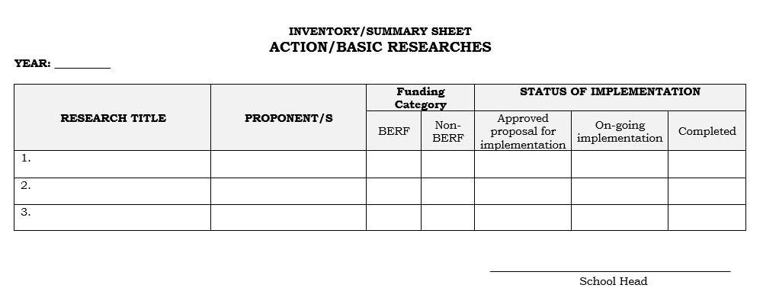
SUGGGESTED TEMPLATE

Slide 14
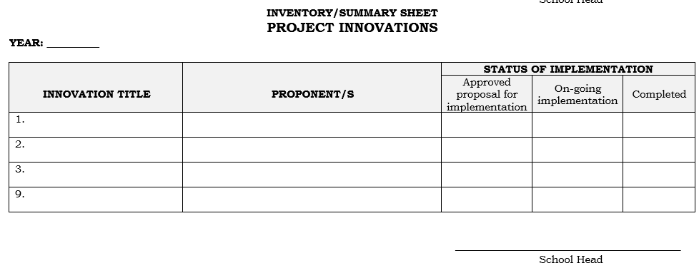
SUGGGESTED TEMPLATE

Slide 15
INDICATOR 1
Means of Verification (MOVs)
3. Documentation of Best practices
a. Documented intervention / CI
b. Positive impact of Intervention
c. Implemented for 3 years
d. Adopted by another school
- request for adaptation to SDS

Slide 16
INDICATOR 1
Means of Verification (MOVs)
4. Students’ Portfolio
- Learner’s profile (Indv. Enrolment)
-Anecdotal Records (except confidential)
- performances and other outputs

Slide 17
INDICATOR 1
Means of Verification (MOVs)
5. Alternative Delivery Mode (ADM) (Process Flow /Flow chart of Intervention / strategies catering to learners
who cannot meet the requirements in a
regular modality

Slide 18
INDICATOR 1
Means of Verification (MOVs)
6.. Institutionalized Programs for Inclusive
Education (ALS, SPED, IPED)
Packaging: - Implementation/action Plan
- Status report
- Accomplishment report
- Photo documentation

Slide 19
INDICATOR 2:
The implemented Curriculum is localized to make it more meaningful to the learners and applicable to life in the community

Slide 20
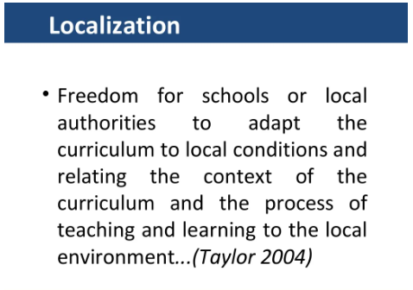

Slide 21
To get a perfect score of 3:
Best Practices in localizing the curriculum are mainstreamed and benchmarked by the schools. There is marked increased in the number of projects that uses the community as learning laboratory, and the school as an agent of change for improvement of the community

Slide 22
EXAMPLES
M and E/Supervisory Reports on Localized curriculum.
List of trainings conducted on Localization/contextualization of materials.
sample performance outputs that could be utilized to improve community life (solid waste management, tree planting activities,linis bayan)
complilation of local literature
sample lessons showing its utilization.
any document showing schools initiated projects that uses the community learnin laboratory (scool-community liveliood project)

Slide 23
INDICATOR 2
Means of Verification (MOVs)
LOCALIZED INSTRUCTIONAL MATERIALS
1. Quality Assured and accepted localized IMs
(SLM, LAS, SIM, Big Books, etc. )
Packing:
- Inventory /Summary sheet of localized IMs
- approval sheet/ certification
- Copy of the material

Slide 24
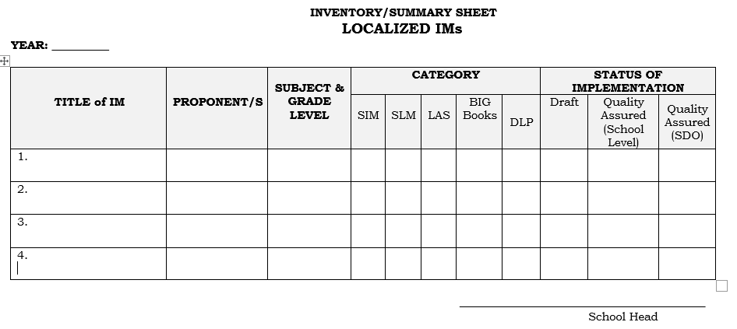
SUGGGESTED TEMPLATE

Slide 25
INDICATOR 2
Means of Verification (MOVs)
2. Localized DLL
- evidence of utilization
- Inventory /Summary sheet)
- Approval Sheet / Certificate
- Copy of DLL

Slide 26
INDICATOR 2
Means of Verification (MOVs)
3. Digitized IMs
a. Summary list of digitized IMs
b. Digital file of IMs (soft & hard copies)

Slide 27
INDICATOR 2
Means of Verification (MOVs)
4. Adaptation of MTB Dictionary /Orthography
- Log book of utilization
5. Organized QA Team for Learning Resources
Development
- Memorandized committee with terms of reference

Slide 28

DIYOS MAMAHES

